Slide 1
X-Copter
Development a platform to test several sensors or
processes for a autonomic aircraft

Slide 2
Project Management Scrum
I am a example for our layout
I am flexible to change my layout quickly

Slide 3
Ready for take off
The first flight test and our perceptions

Slide 4
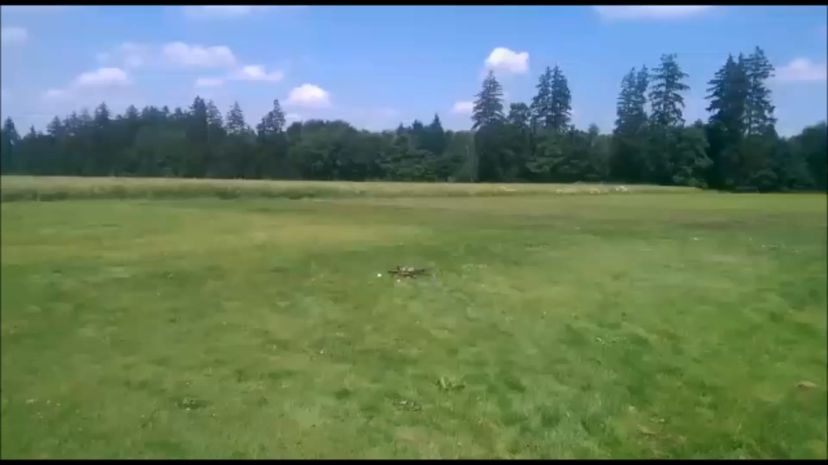
The „flight“

Slide 5
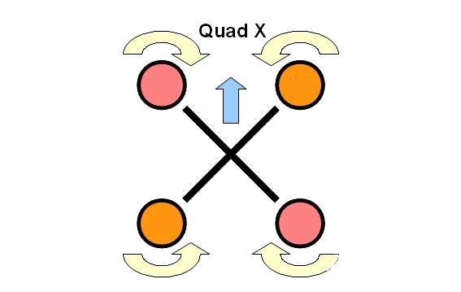
reasons for the crashes
Wrong assembly of the motors

Slide 6
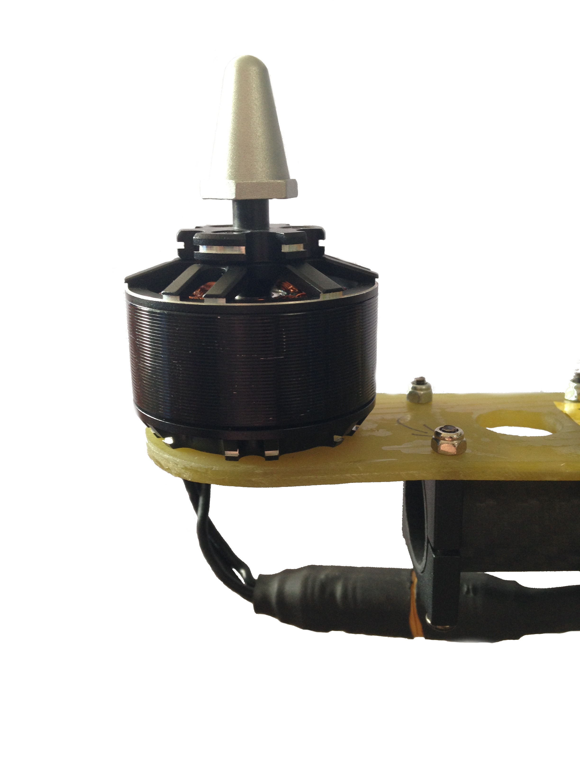
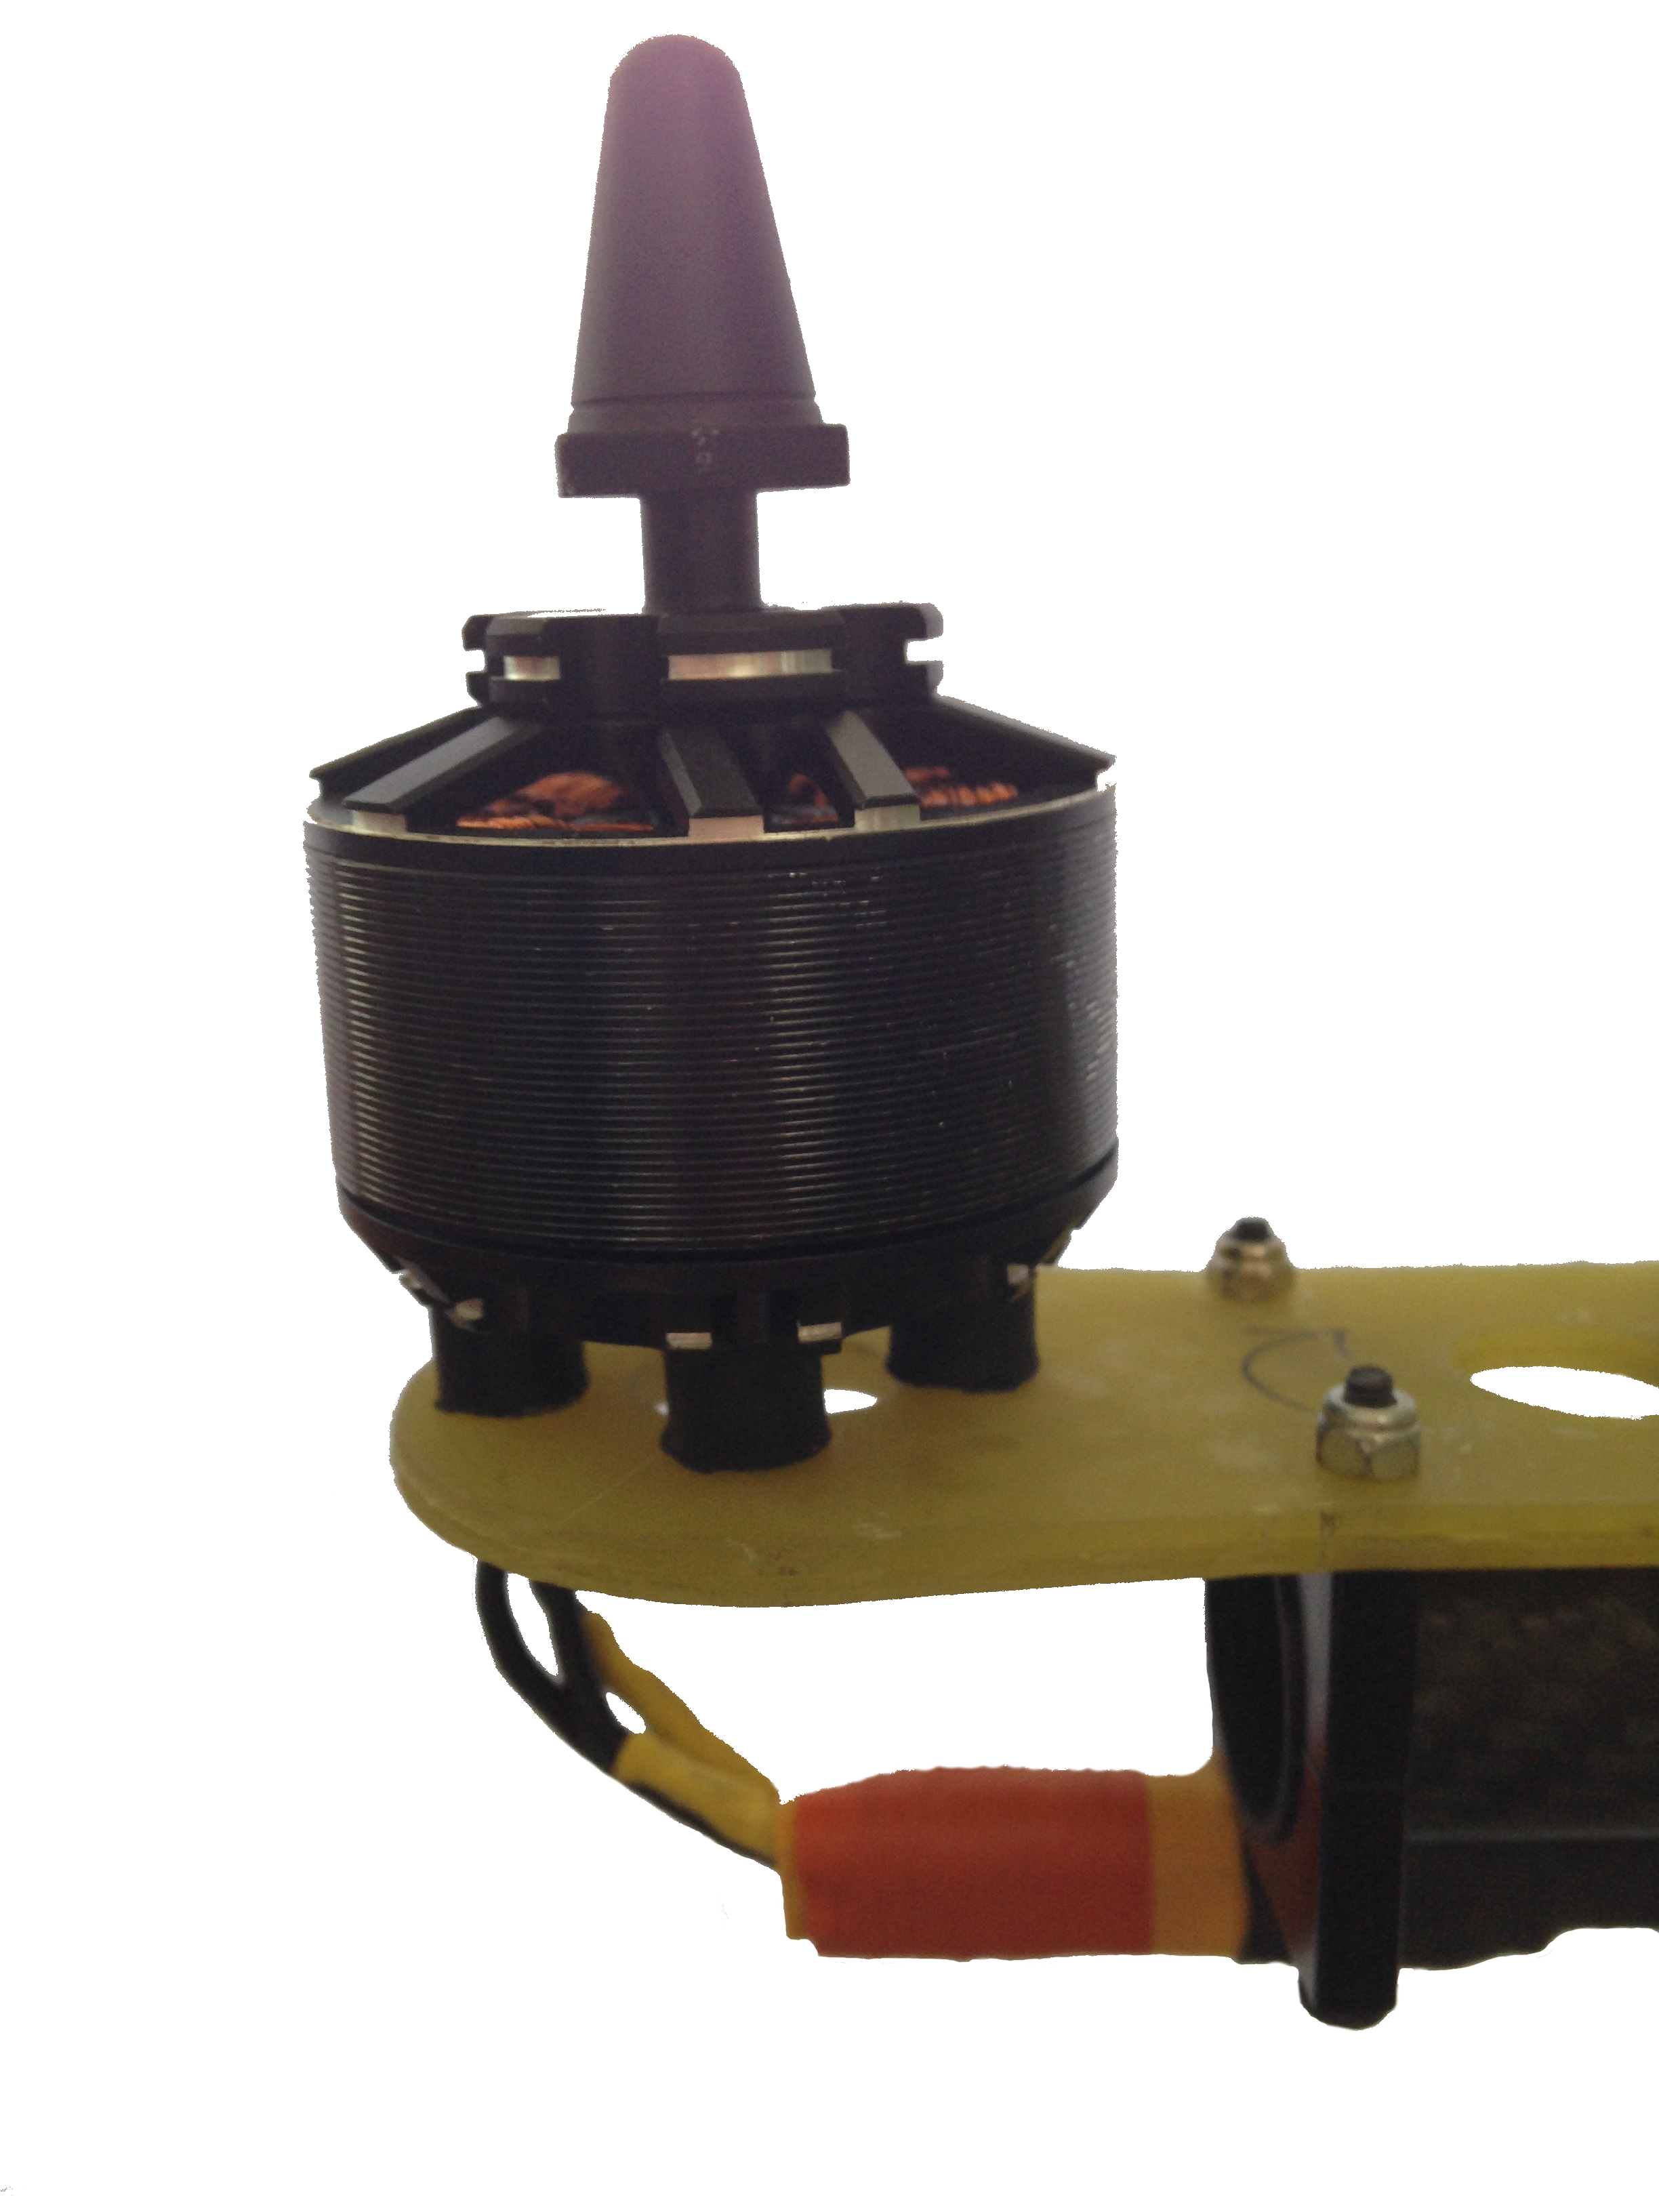
Reasons for the crashes

Slide 7
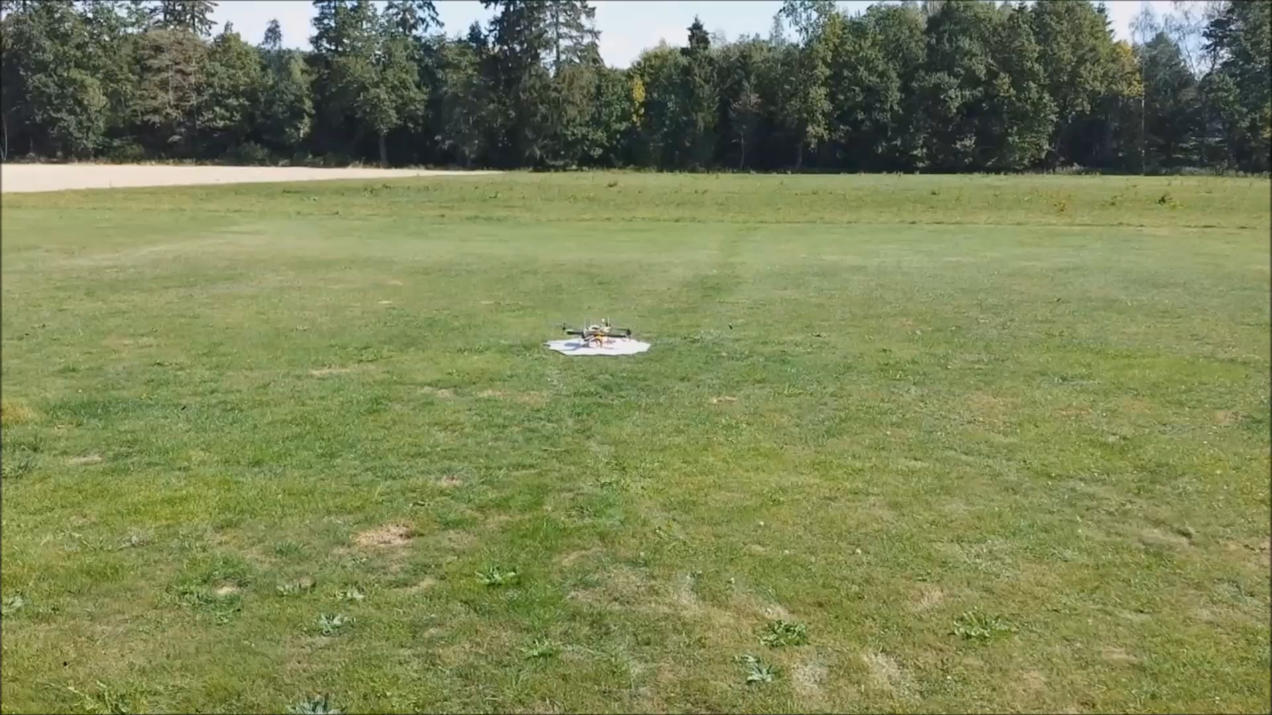
Time for the real flight

